Slide 1
Exploratory Predictive analysis on Donor Behavior
Group- 14
Prepared by:
Dipendu Chanda
Piyush Kulkarni
Ramesh Kumar Nunna
Ramkumar Sreeram
Shiva Abhishek Akella

Slide 2
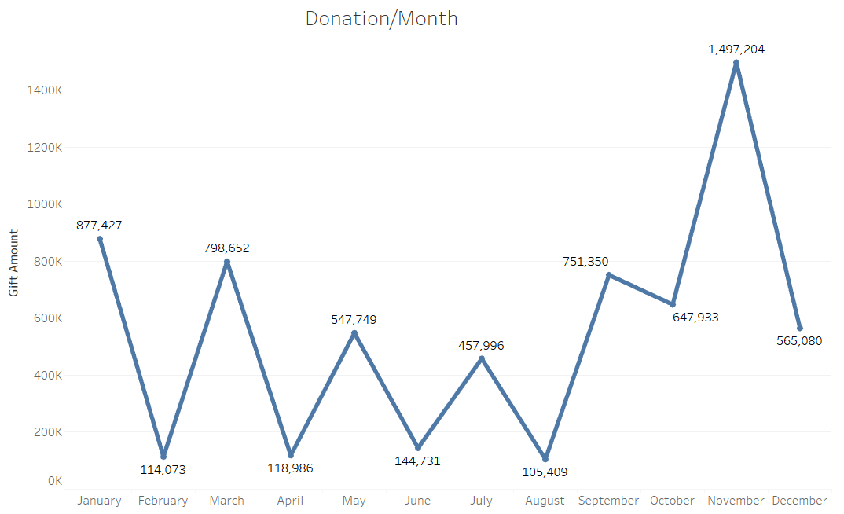
Donation Analysis
Most of the donations occur in Holiday season.
Last few months of the year make up for the majority of the donations. It is called the Giving Season for the nonprofit community
The donations from year 2004 and 2005 decreased. It is due to churning of donors further explained in RFM analysis.

Slide 3
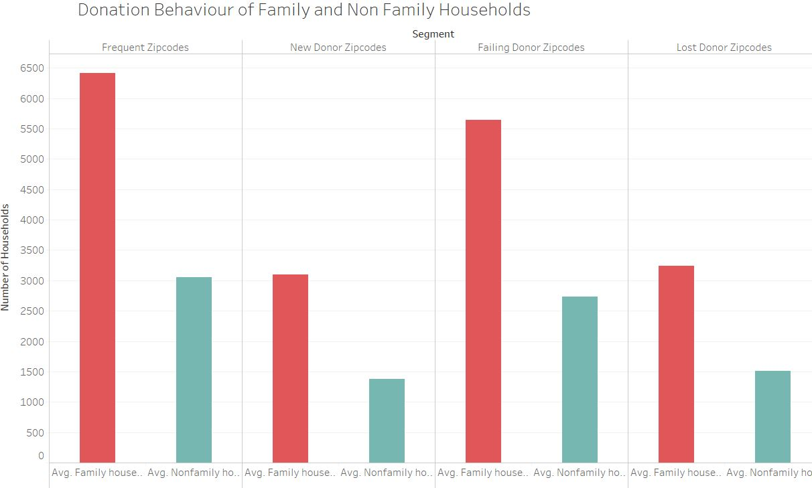
Donor Behavior
Donors with higher income tends to donate slightly more
Family Households tends to donate more
Male tends to respond more to our appeals and donate greater number than females
Appeals are more effective on Zip code with more Urban population

Slide 4
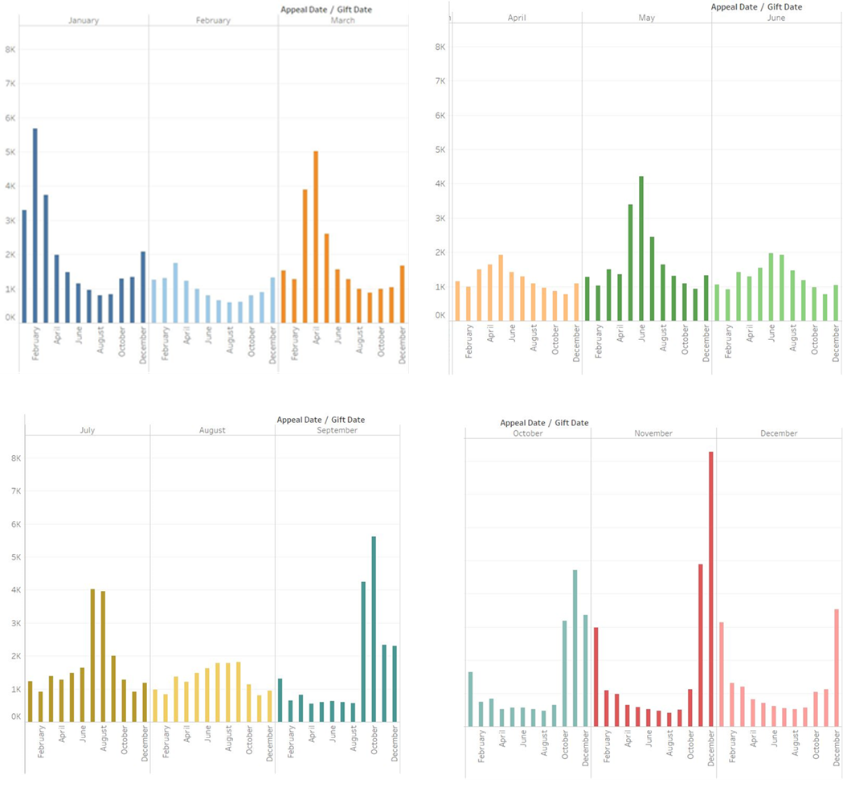
Impact of Appeals
Appeals has an emotional factor associated with it which effects the donation behavior
Gift date and donation date are highly related
There is a successive monthly relationship between appeals and donation
Maximum donations for a appeal occur in the next moth of the appeal date

Slide 5
Donation Analysis
Factors Affecting the Donations are
Average Household Income
House Hold Type – Urban, Semi Urban
Household Type - Family Households
Marital Status, Presence of Kids

Slide 6
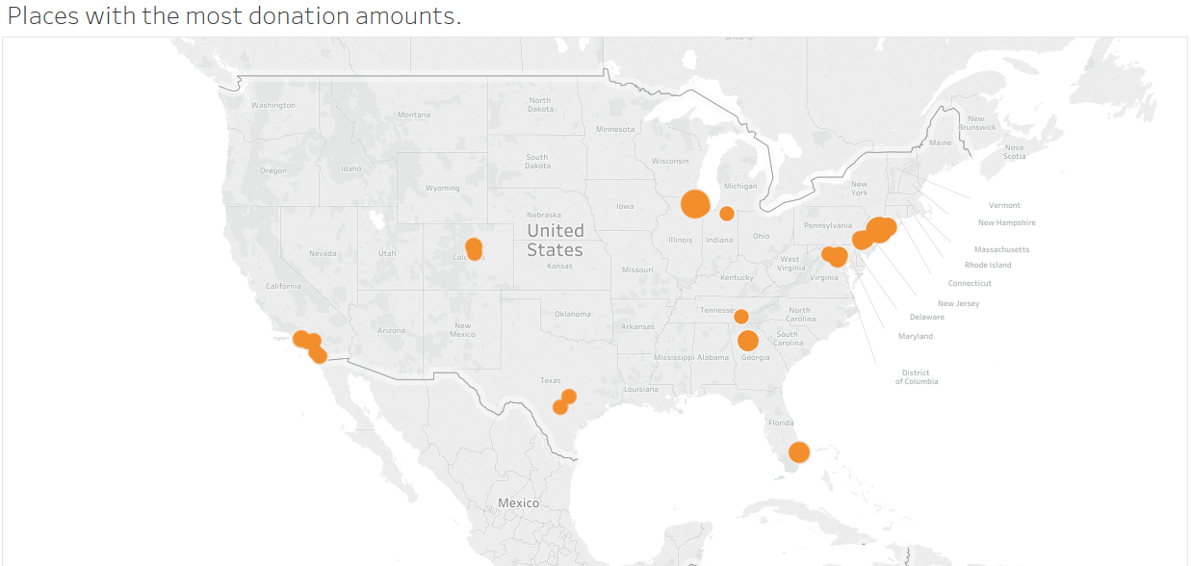
Who are our top donors?
Most of the top donations are coming from East and West coast
Why? – Explained using RFM

Slide 7
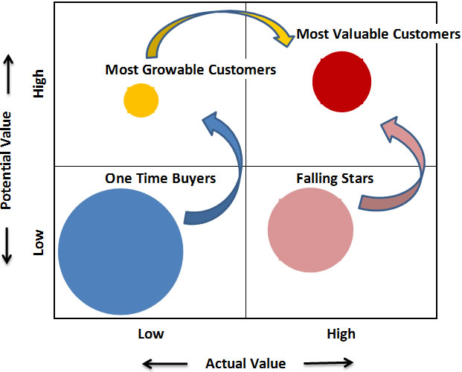
Who are Our Best Donors?

Slide 8
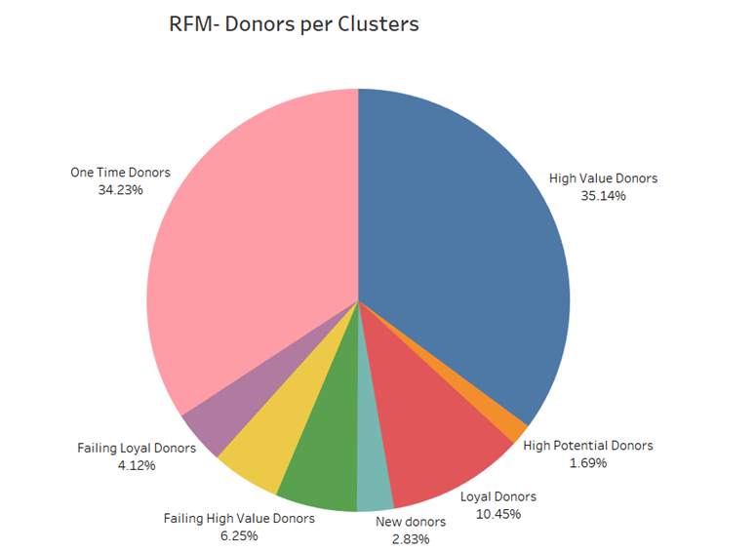
Donor Level RFM
To identify existing donors who are likely to respond to appeals
Targeted approach specific to donor’s characteristic

Slide 9
Donor Level RFM
Segment 1: High Value Donors
Segment 2: New donors with high donation amount High Potential Donors “Big fish”
Segment 3: Frequent donors who donate small amount regularly Loyal Donors
Segment 4: New donors who have just started to donate New donors
Segment 5: High value donors who have not donated recently. Could be possible that the have churned. Try to bring them back Failing High Value Donors
Segment 6: Donors who donated large amount in past but failed to donate regularly Failing Starters
Segment 7: These are the customers who used to donate often but stopped donating Failing Loyal Donors
Segment 8: Donors who donated very few times on past but didn’t continue One Time Donors “OK, as you asked nicely”

Slide 10
Donor Level RFM Insights
Present- only 2.83% new donors: the NGO should reach new donors
More targeted appeals to be sent to high potential donors (Big Fish)
High Value Donors are loyal customer; they should not be neglected but not to bogged with many appeals
Failing High Value Donors, Failing Starters, Failing Loyal Donors were loyal donors who stopped donating recently; Further investigation needs to be done
One Time Donors which comprises of 34.23% are the donors who just donated few times in the past. Why?

Slide 11
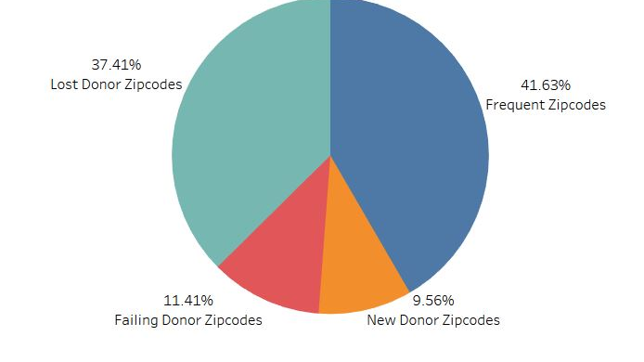
Zip Level RFM
To find future donors in accordance to their zip code
Likeliness of getting donors based on the Zip code characteristic

Slide 12
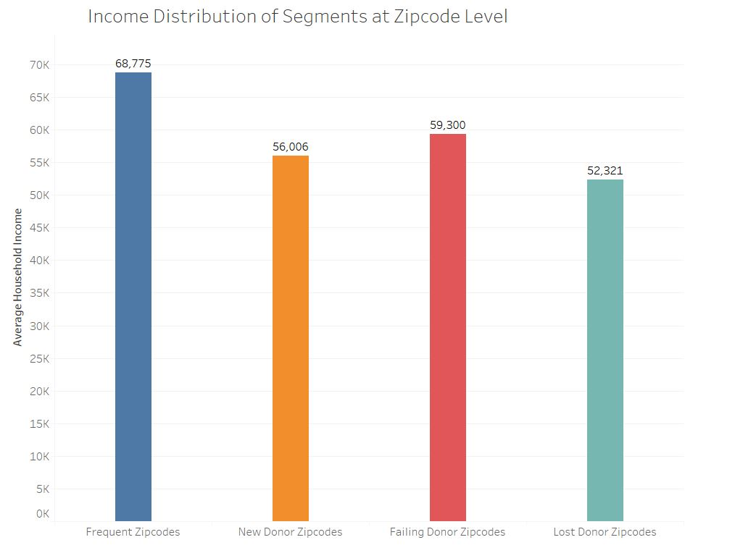
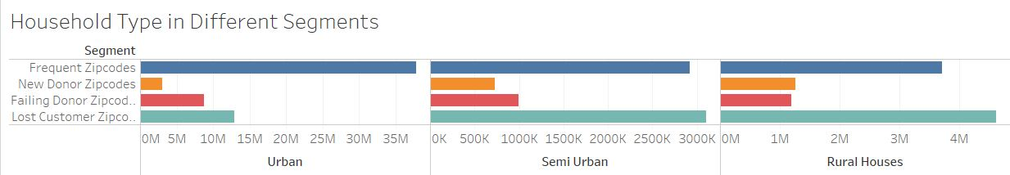
Zip Level RFM
Segment 1:Frequent Donor Zip codes
Average Household Income: $68,777
Mostly consist of urban households but have fair share of semi urban as well as rural households.
Segment 2: New Donor Zip codes
Average household income: $56,000
Mostly consist of Semi urban and Rural households
Segment 3: Failing Donor Zip codes
Largely dominated by urban and rural households
Segment 4: Lost Donor Zip codes
Dominated by Urban households but Semi Urban and Rural Households also have sizable share

Slide 13
Recommendations
For more detailed analysis, donor level demographic data needs to be incorporated
If donor level data is not available a field study can be designed with different segments of donors and their demographics could be treated as base characteristics for that segment
More analysis should be done as in why a particular donor donates and what factor influence him to donate and can be used in sending donor specific appeals
Appeal can have a feedback mechanism to track the success of the appeal directly. Tools like google analytics can be used to track the success of emails. Effectiveness of telephonic appeals and the conversation status can be tracked by the executives
Find out the churn ratio and use this find out the significant driving factors for the churn of donors
Deploy suitable marketing campaigns/ donor relationship programs to mitigate churn and engage the donor for future donation
Identify which marketing campaign resonates emotionally with what age group of people while considering other geopolitical to send out more appeals to people via the medium they are most receptive to

